Slide 1
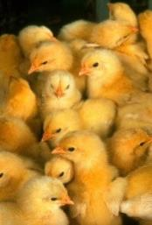
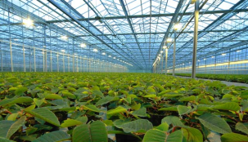
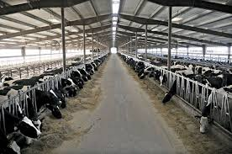
Drive systems for livestock
Geared To Move Your World

Slide 2
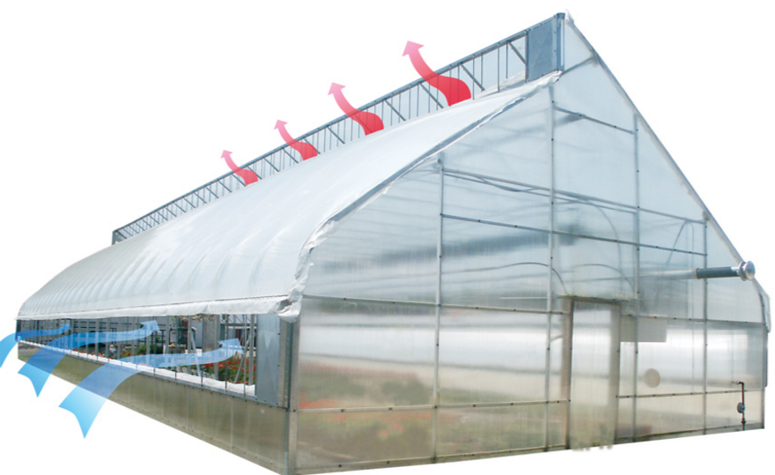
Ventilation

Slide 3
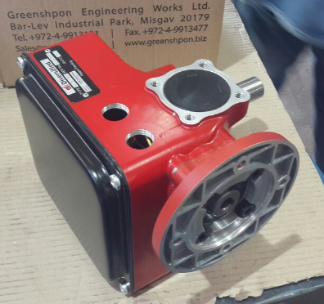
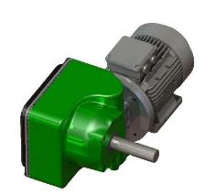
G3 Drive-Availability
G3 motor gearboxes are available in various size:
Drive torques up to 150 Nm – 650 Nm at 50Hz and 60Hz.
Rotation speeds from 1 to 6 rpm at 50 Hz and 60Hz.
High and low counter mechanism speed .

Slide 4
Applications
Most powerful curtain/ventilation gear drives (150-650 Nm)
Shading and Thermal screens in greenhouses.
Hoist drive units for feeding/drinking lines / heating systems.
Gearboxes for feeding lines.
Roll up long curtains/ vent systems, climbing / fixed position for dairy and swine housing.
Gearboxes for Ventilation equipment.

Slide 5
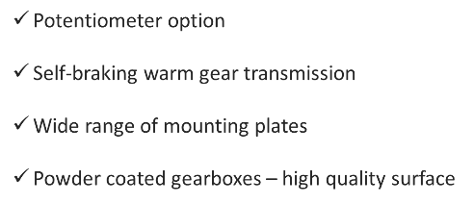
Main features
Single / Double shaft
Output shafts sized to serve most common designers
Simple and accurate limit switches
Totally sealed and lubricated for life
Internal Manual open/close switches
Internal safety switch

Slide 6
Advantages
Friendly interface , easy to operate.
Installation and adjustment by one person !
Lighter and Stronger – than any other drive
Safety Switch – prevents overriding of the limit switches.
Possibility of many different applications.
Heavy Duty Construction for Long life .
No Regular maintenance required .
Instant Reversing 1/4 - 1/3 – HP Motor .
Belt Concept – Longer Life
Self-braking worm gear transmission ensures that the output shaft locks when the drive unit stopes.

Slide 7
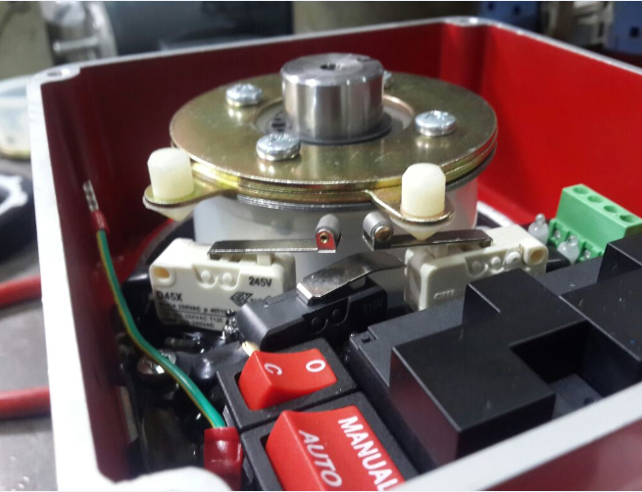
Limit switches system - counter mechanism
Greenshpon developed a special counter mechanism system and the most important advantage of the G3:
Setting limit switches system by one person
Easy to use , very user friendly.
Counter mechanism is characterized by precision, reliability and safety – zero backlash.
The G3 limit switch system is a combination of duty and safety switches.
The switches used are selected for high compatibility and control technology.

Slide 8
Electric card availability
For applications worldwide, Greenshpon has a wide selection of PCB electrical card for motor gearboxes.
Greenshpon PCB card can be fitted with the following electric motors:
3-Phase euro voltage, for use on mains voltages of 220V at
50Hz and 60Hz.
1-Phase with CSA approval for use on mains voltages of 110V
at 60Hz.
1-Phase with CSA approval for use on mains voltages of 220V
at 60Hz

Slide 9
Limit switch system- Advantages
Internal Manual/ Automatic OPEN/CLOSE switches– simplifies setting
Simple Accurate limit switch – zero backlash
LED Indication – shows power in/out & switch activation
Safety Switch – prevents overriding of the limit switches.
Printed Circuit Board – greater reliability

Slide 10
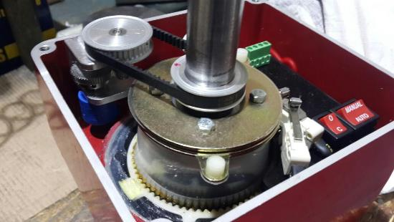
potentiometer mechanism
Using the optional installation set with potentiometer, enables to get precise feedback of the position of the drive system to the control system.

Slide 11
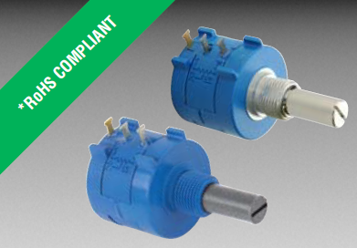
Advantages
Grants precise position at every moment of the working drive system(start ,intermediate ,brake (end))
Compact and easy to install in various drive systems.
Could fit to any number of turns(revolutions) of the gear drive until its finish full movement.
Have various resistance values range.

Slide 12
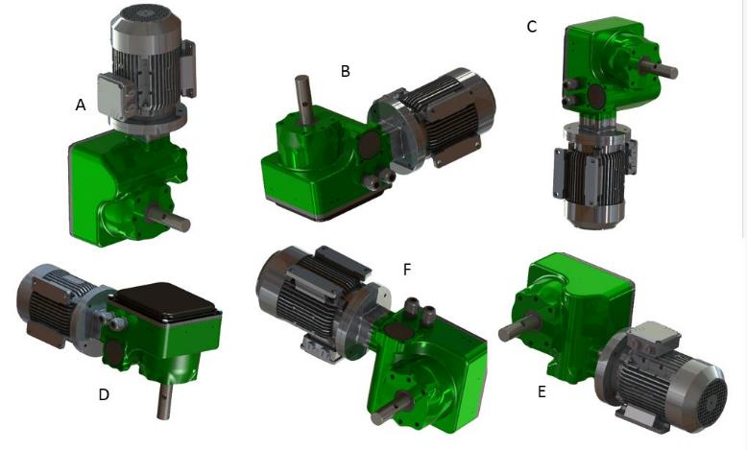
Allowable Mounting Positions

Slide 13
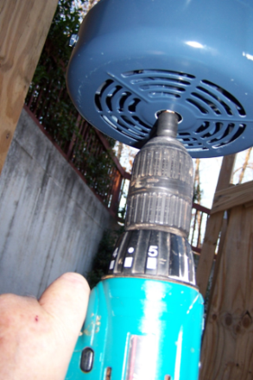
Emergency Opener
Spin Open with Cordless Drill and 3/8 inch Nut Driver

Slide 14
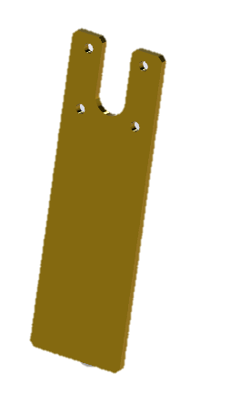
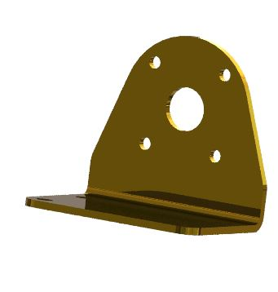
Mounting Plate
Different types of mounting plates .

Slide 15
Motor Gearbox – Selection table
Output Torque Nm | Output speed RPM(60HZ) | Output speed RPM(60HZ) | Output RPM (50HZ) | Output RPM (50HZ) | Output RPM (50HZ) | Ratio | Motor Power HP/KW | Code
 | 3560 | 1780 | 2800 | 1450 | 900
150 | 42 | 21 | 33 | 17 | 10.5 | 85 | 0.33/0.25 | G3 150/85
150 | 1.2 | 0.6 | 0.9 | 0.5 | NA | 3000 | 0.33/0.25 | G3 150/3000
250 | 4.7/2.5 | 2.0/1.3 | 3.7/2.0 | 1.8/1.0 | 1.2/0.66 | 750/1500 | 0.25/0.18 | G3 250/750
250 | 7.1/3.6 | 3.6/1.8 | 5.6/2.8 | 2.9/1.5 | 1.8/0.9 | 500/1000 | 0.25/0.18 | G3 250/500
450 | 4.7/2.4 | 2.4/1.2 | 3.7/1.9 | 1.9/0.97 | 1.2/0.6 | 750/1500 | 0.33/0.25 | G3 450/750
650 | 4.7/2.4 | 2.4/1.2 | 3.7/1.9 | 1.9/0.97 | 1.2/0.6 | 750/1500 | 0.5/0.37 | G3 650/750

Slide 16
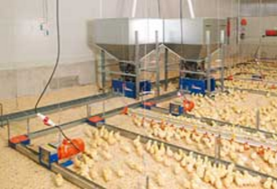
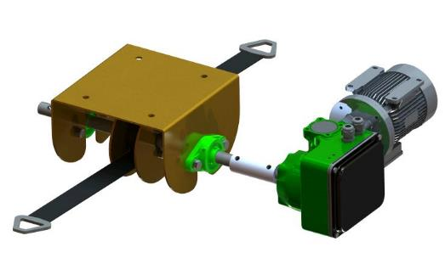
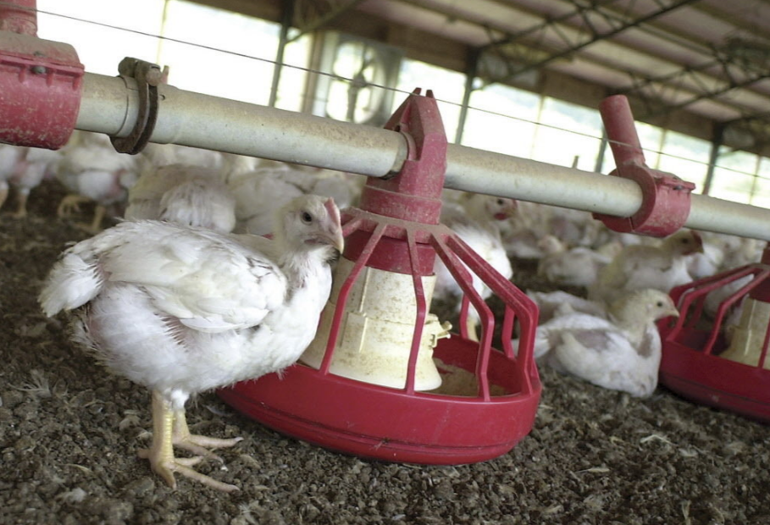
Special Applications

Slide 17
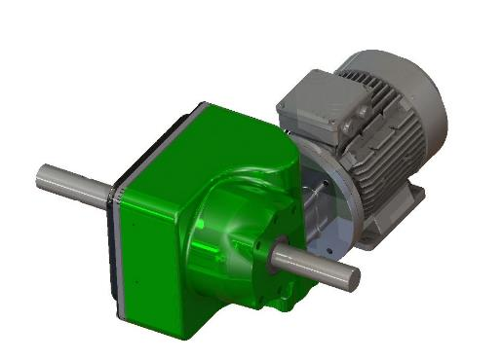
Dual Shaft Drives
For applications requiring mounting and torque in two directions, curtain roll-ups , rack and pinion , winching.

Slide 18
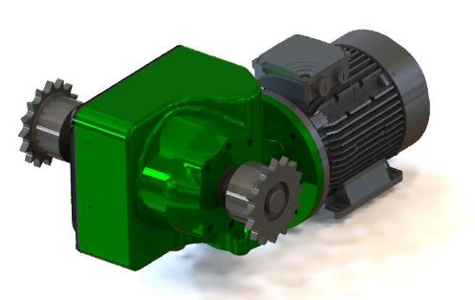
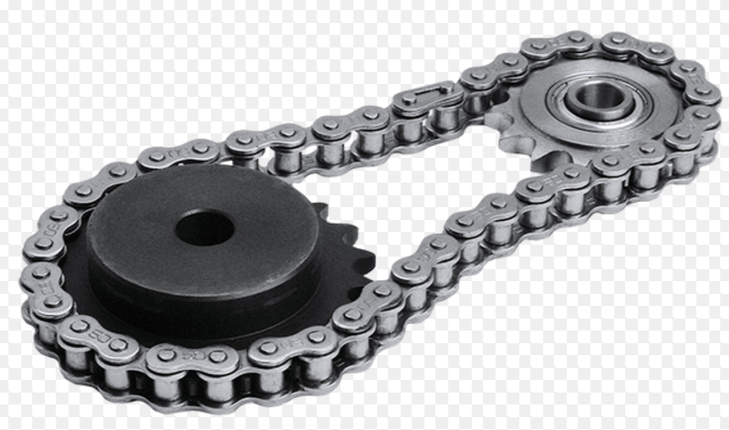
Sprocket-Chain
The use of sprocket-chain application needed to transmit rotary motion between two shafts where gears are unsuitable or to impart linear motion

Slide 19
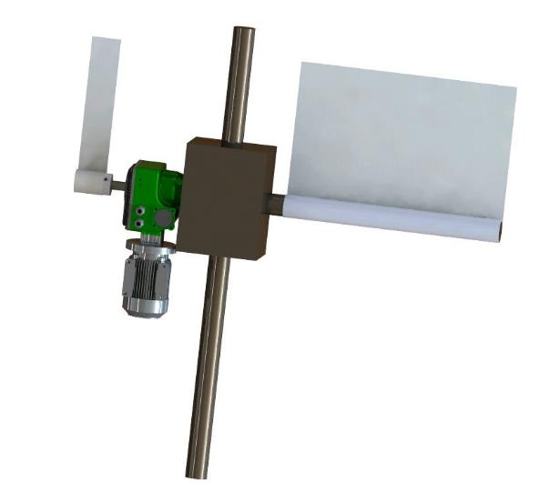
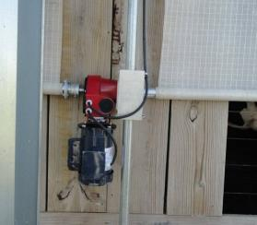
Climber System
The climber system ensures easy system for curtains allowing maximum ventilation.

Slide 20
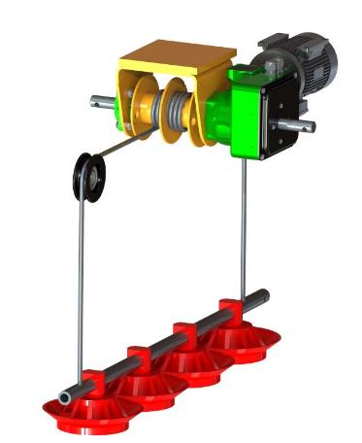
Winching system
G3 winch assembly grants many options of lifting/feeding/watering lines
For Greenhouses and other elevating proposes.
The winches connect to the system either with cables and belts.

Slide 21
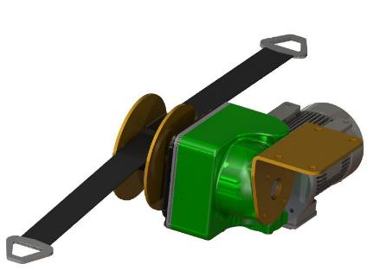
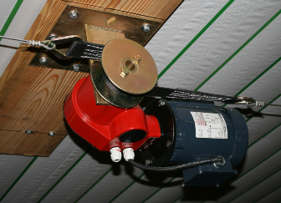
G3 Base Drum Winch
Winch drum on the driven shaft ( single shaft only) is available with single or double cable winch drum – equipped with a high quality safety belt (1.5,4.5,6,8 meter)

Slide 22
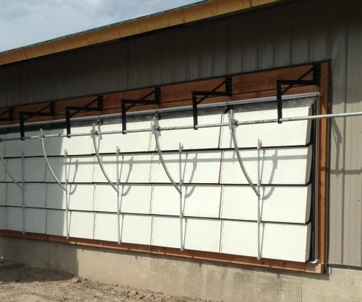
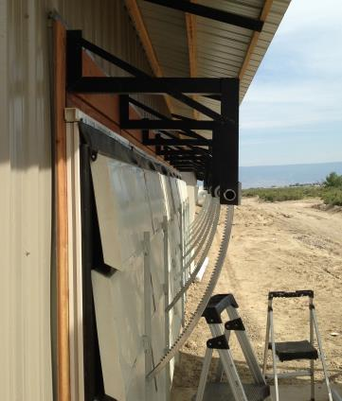
Tunnel Shutter system with rack and pinion

Slide 23
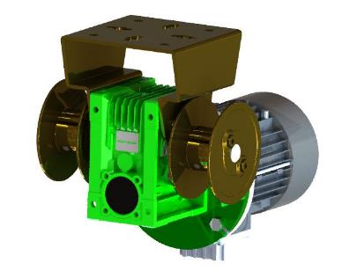
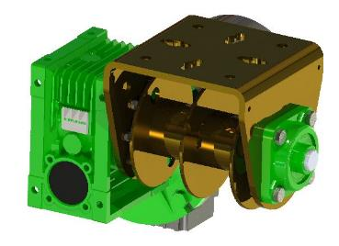
Line Lifter System
Hoisting of feeding and drinking lines by drum and belt/cable per customer demand.

Slide 24
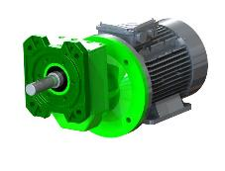
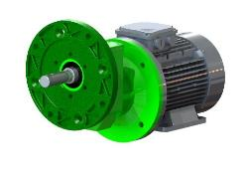
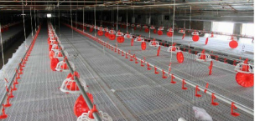
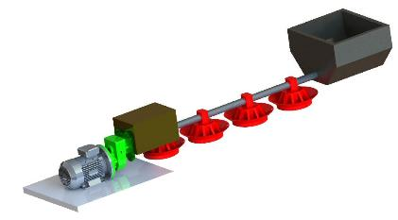
GRF – Feeding
GRF – feeding is a product line dedicated to poultry farming (automatic feeding systems, opening/closing of windows, movement of feeding trough by lead screw, etc)
Feed is transported in two main ways, either by screw or chain feeder systems. Both can be used in these applications , transporting feed in small and large quantities when necessary.

